Slide 1
Model Presentation:
Contract for Higher Order Functions
Benjamin Fitzpatrick, Oscar Dong, Zexuan Zhou

Slide 2
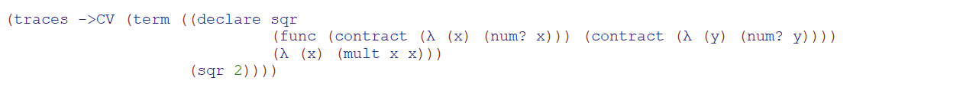
Implementation
Our program looks like this:
It has two parts, the declare part, and the expression part
The declare is basically a list of contracts with an expression

Slide 3
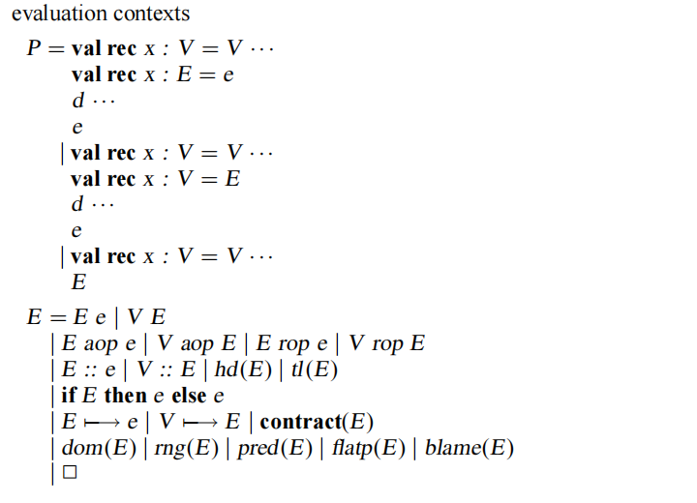
Core Syntax:

Slide 4
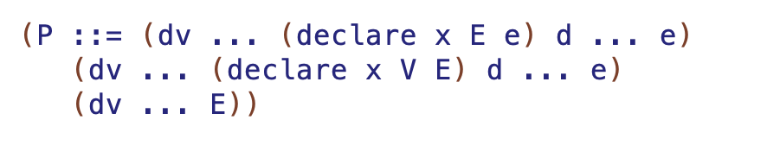

Slide 5
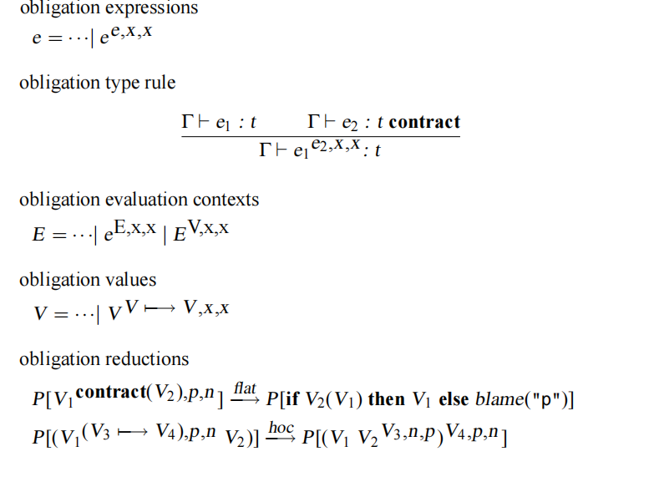
Obligation Reduction

Slide 6
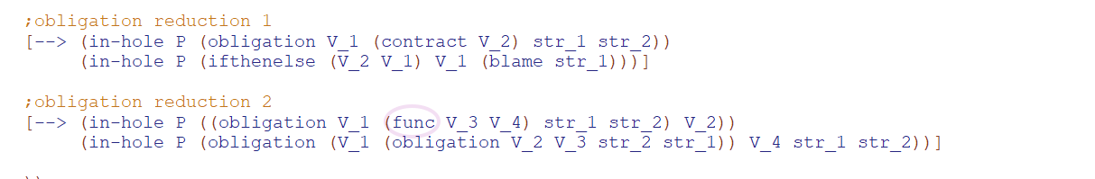
Implementation

Slide 7

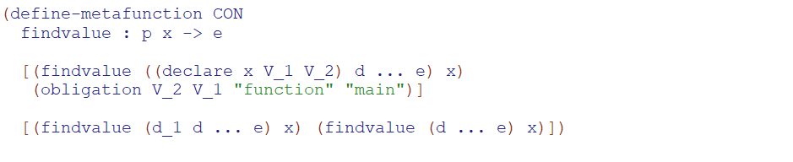
At the last stage of P, we have an expression with a bunch of free variables in it. And we replace them with this step:

Slide 8
Where to assign blame
At the last stage of P, we have an expression with a bunch of free variables in it. And we replace them with this step:
If the function x does not follow the contract, “function” is blamed while “main” is blamed if an application to the function does not follow contract in the main expression

